Slide 1
GO-BACK-N & SELECTIVE REPEAT ARQ -by Hitesh Nautiyal

Slide 2
Go-Back-N ARQ :-
Go Back N ARQ which stands for Go Back N Automatic Repeat Request (ARQ) is a data link layer protocol that is used for data flow control purposes. It is a sliding window protocol in which multiple frames are sent from sender to receiver at once. The number of frames that are sent at one depends upon the size of the window that is taken.
The flow control protocols are generally divided into two categories i.e.
Stop and wait protocol
Sliding window protocol.
The difference between these two categories of flow control protocols is that in the stop and wait protocol, only one data frame is sent at a time from sender to receiver. While in sliding window protocol, multiple frames can be sent at a time from sender to receiver.
Go Back N ARQ is a sliding window protocol which is used for flow control purposes. Multiple frames present in a single window are sent together from sender to receiver.
Pipelining is allowed in the Go Back N ARQ protocol. Pipelining means sending a frame before receiving the acknowledgment for the previously sent frame.

Slide 3
Working :-
1. Data packets are divided into multiple frames. Each frame contains information about the destination address, the error control mechanism it follows, etc. These multiple frames are numbered so that they can be distinguished from each other.
2. The integer 'N' in Go Back 'N' ARQ tells us the size of the window i.e. the number of frames that are sent at once from sender to receiver. Suppose the window size 'N' is equal to 4. Then, 4 frames (frame 0, frame 1, frame 2, and frame 3) will be sent first from sender to receiver.
3. Receiver sends the acknowledgment of frame 0. Then the sliding window moves by one and frame 4 is sent.
4. Receiver sends the acknowledgment of frame 1. Then the sliding window moves by one and frame 3 is sent.
5. The sender waits for the acknowledgment for some fixed amount of time. If the sender does not get the acknowledgment for a frame in the time, it considers the frame to be corrupted. Then the sliding window moves to the starting of the corrupted frame and all the frames in the window are retransmitted.

Slide 4
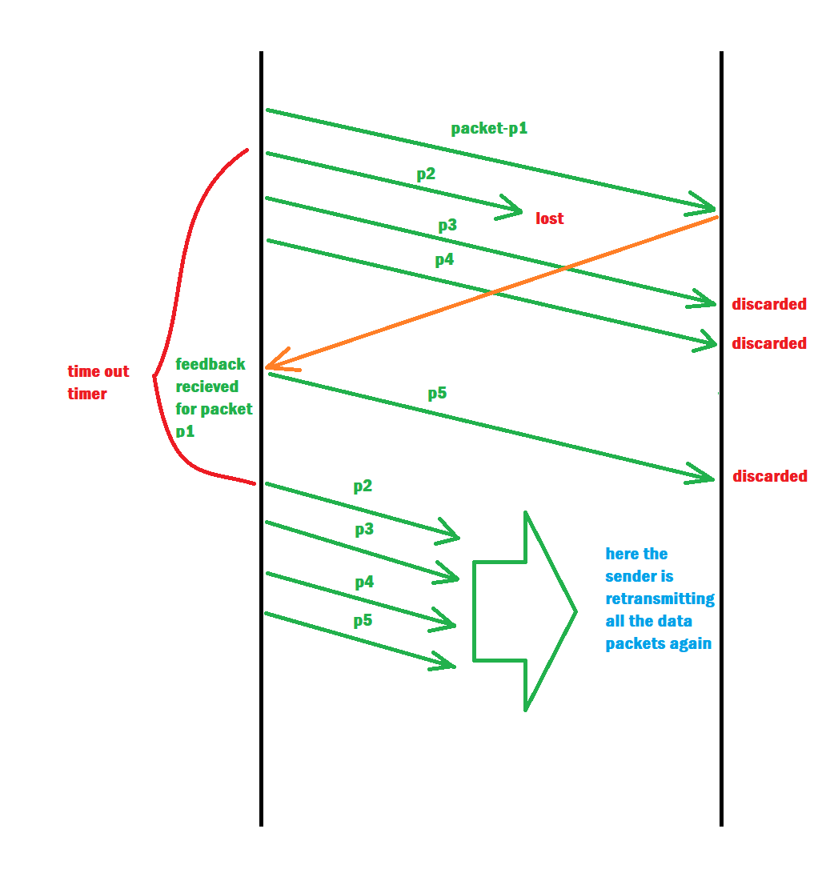
Flow-Diagram :-

Slide 5
Selective Repeat :-
Selective repeat protocol, also known as Selective Repeat Automatic Repeat Request (ARQ), is a data link layer protocol that uses the sliding window technique for reliable data frame delivery. Only erroneous or lost frames are retransmitted in this case, while good frames are received and buffered.
Selective Repeat ARQ is used in the data link layer for error detection and control. The sender sends several frames specified by a window size in the selective repeat without waiting for individual acknowledgement from the receiver, as in Go-Back-N ARQ.

Slide 6
Working :-
In Selective Repeat ARQ, only the erroneous or lost frames are retransmitted, while correct frames are received and buffered.
While keeping track of sequence numbers, the receiver buffers the frames in memory and sends NACK (negative acknowledgement) for only the missing or damaged frame.
The sender will send/retransmit the packet for which NACK (negative acknowledgement) is received.

Slide 7
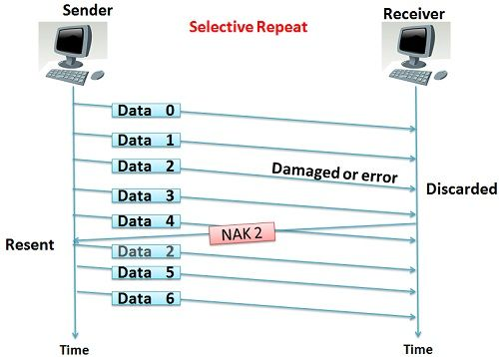
Flow-Diagram :-

